Slide 1
Projections
3D -> 2D

Slide 2
Important Terms Related to Projection
n dimension to n-1 dimension
Center of Projection (CoP)-The point from where projection is taken. It can either be light source or eye position.
Projection Plane -The plane on which projection of the object is formed.
Projectors -Lines emerging from center of projection, and hitting the projection plane after passing through a point in the object to be projected.

Slide 3
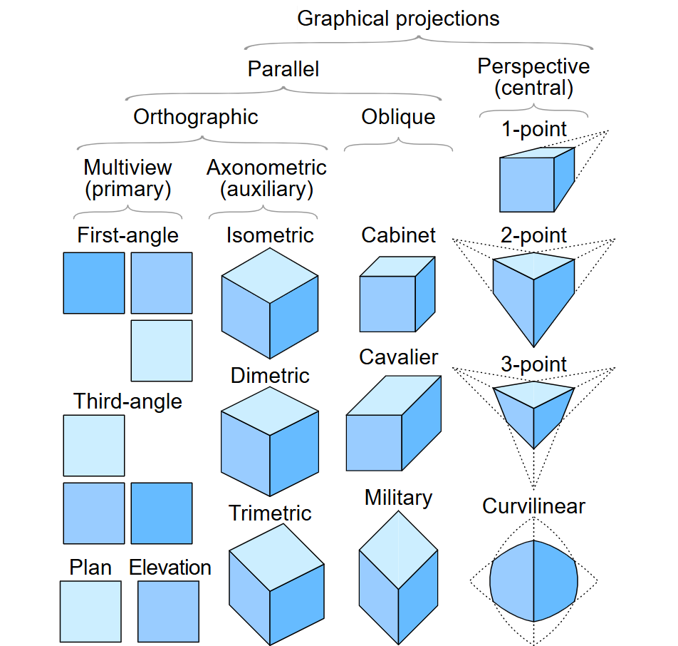

Slide 4
two graphical projection categories
Parallel projection
Orthographic projection
Oblique projection
Perspective (Central) projection
Vanishing Point

Slide 5
Parallel Projection
Parallel projection discards z-coordinate and parallel lines from each vertex on the object are extended until they intersect the view plane.
In parallel projection,
we specify a direction of projection instead of center of projection.
the distance from the center of projection to project plane is infinite.
we connect the projected vertices by line segments which correspond to connections on the original object.
parallel lines remain parallel and angles are not preserved. Various types of parallel projections are shown in the following hierarchy.
Parallel projections are less realistic, but they are good for exact measurements.

Slide 6
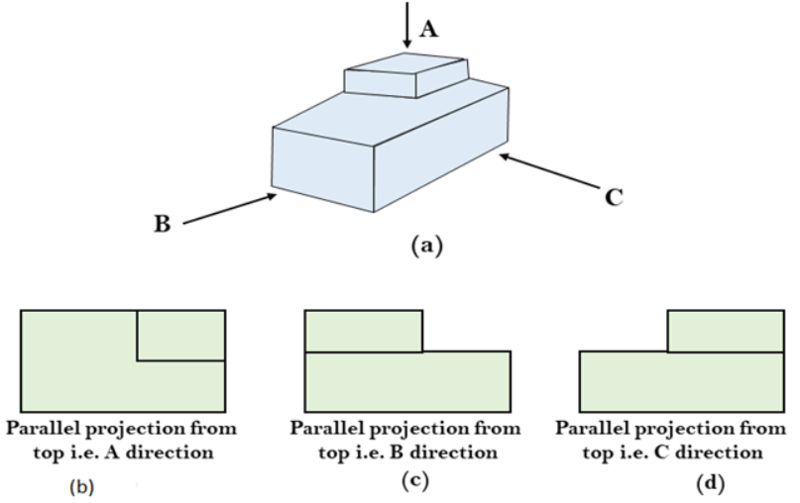
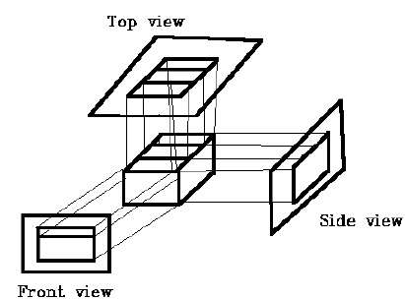
Parallel->Orthographic projection
In orthographic projection the direction of projection is normal to the projection of the plane.
CoP is at infinity.
DoP is normal to the projection Plane. (Angle 90⁰)
Three types of orthographic projections −
Front Projection
Top Projection
Side Projection

Slide 7
Parallel-> Oblique Projection
In oblique projection,
the direction of projection (DoP) is not normal to the projection plane.
we can view the object better than orthographic projection.
There are two types of oblique projections − Cavalier and Cabinet.
The Cavalier projection makes 45° angle with the projection plane.
(tan 45° = 1 )
the foreshortening factors for all three principal directions are equal.
The Cabinet projection makes 63.4° angle with the projection plane.
lines perpendicular to the viewing surface are projected at ½ their actual length.

Slide 8
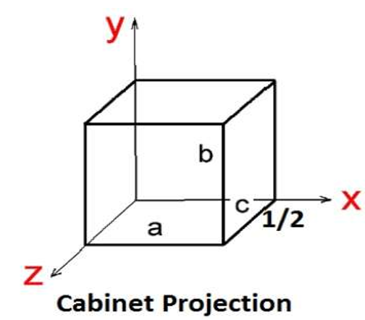
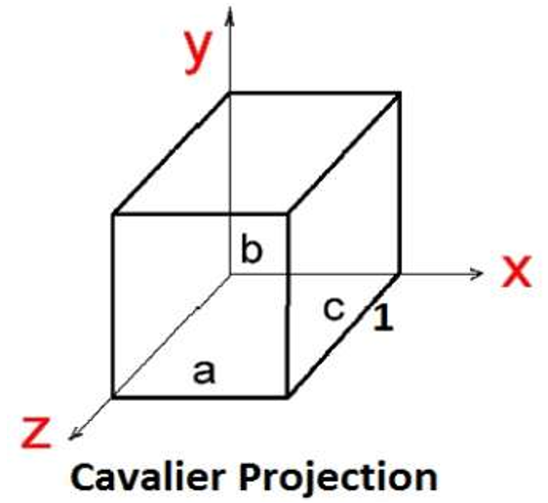
Cavalier: All lines perpendicular to the projection plane are projected with no change in length.
Cabinet: All lines perpendicular to the projection plane are projected to one half of their length. These give a realistic appearance of object.

Slide 9
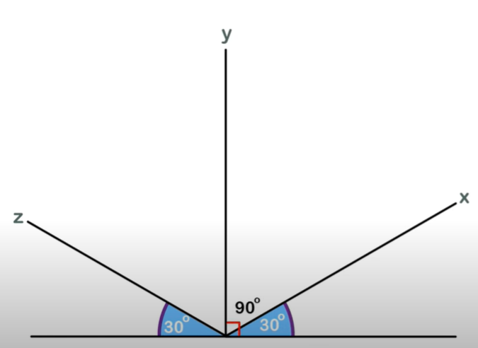
Parallel->Orthographic-> Axonometric:
Isometric Projection: All projectors make equal angles generally angle is of 30°.
Dimetric: In these two projectors have equal angles. With respect to two principle axis.
Trimetric: The direction of projection makes unequal angle with their principle axis.

Slide 10
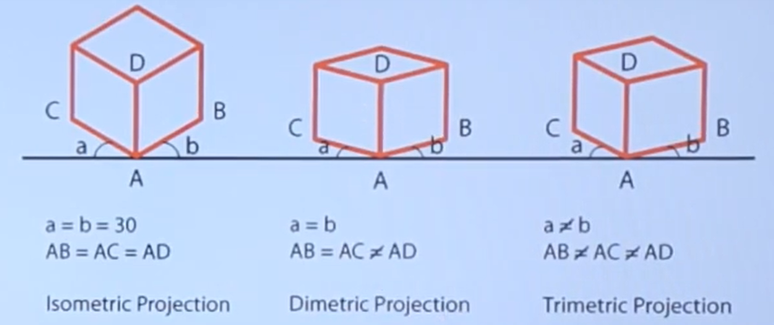
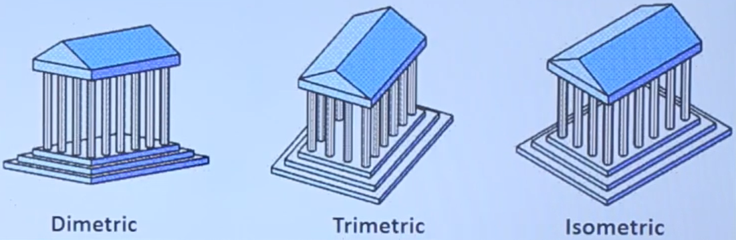
Parallel->Orthographic-> Axonometric:
Isometric Projection: All projectors make equal angles generally angle is of 30°.
Dimetric: In these two projectors have equal angles. With respect to two principle axis.
Trimetric: The direction of projection makes unequal angle with their principle axis.

Slide 11
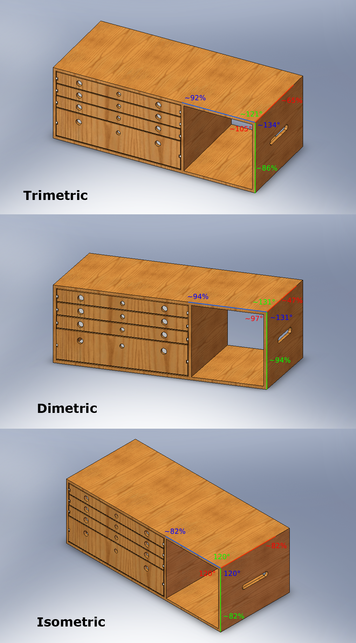
Ex:

Slide 12
Perspective Projection
CoP is at a finite distance.
and the size of the object varies inversely with distance which looks more realistic.
The distance and angles are not preserved and parallel lines do not remain parallel. Instead, they all converge at a single point called center of projection or projection reference point.
There are 3 types of perspective projections:
One point perspective projection is simple to draw.
Two point perspective projection gives better impression of depth.
Three point perspective projection is most difficult to draw.

Slide 13
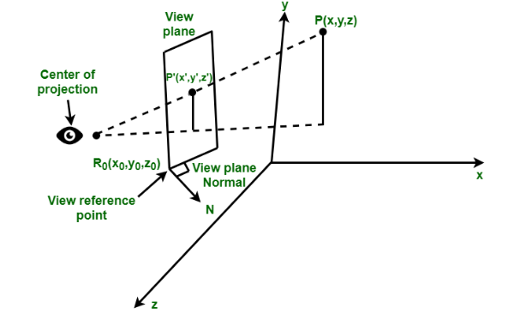
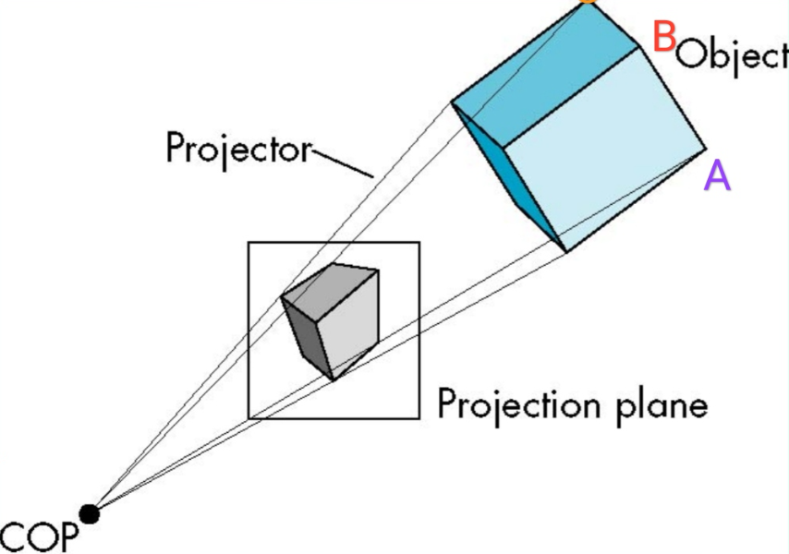
Perspective Projection

Slide 14
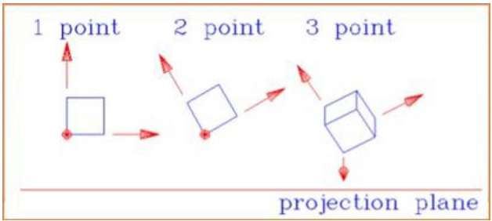
The following figure shows all the three types of perspective projection −
Center of Projection (COP): It is the location of the eye on which projected light rays converge.
Vanishing Point: All lines appear to meet at some point in the view plane.

Slide 15
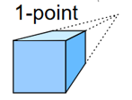
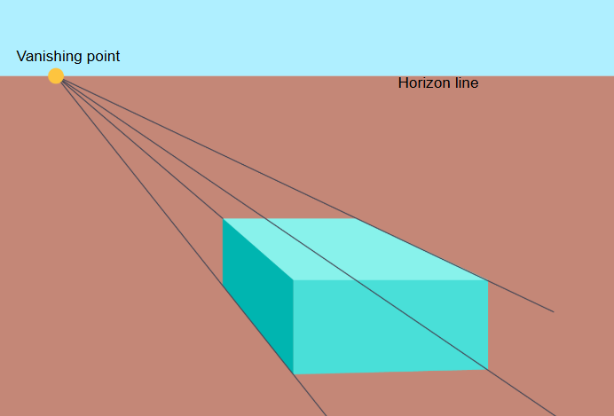
Vanishing Points
One-point perspective image

Slide 16
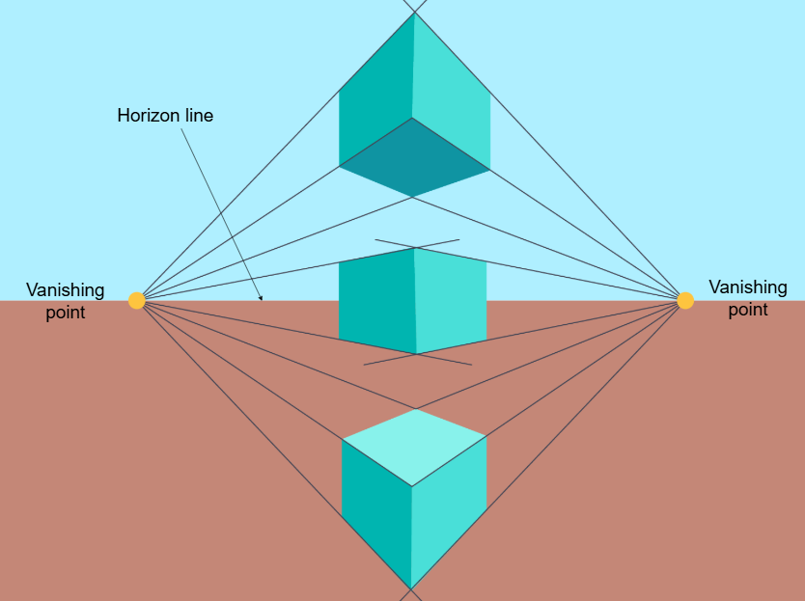
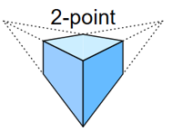
Two-point perspective image

Slide 17
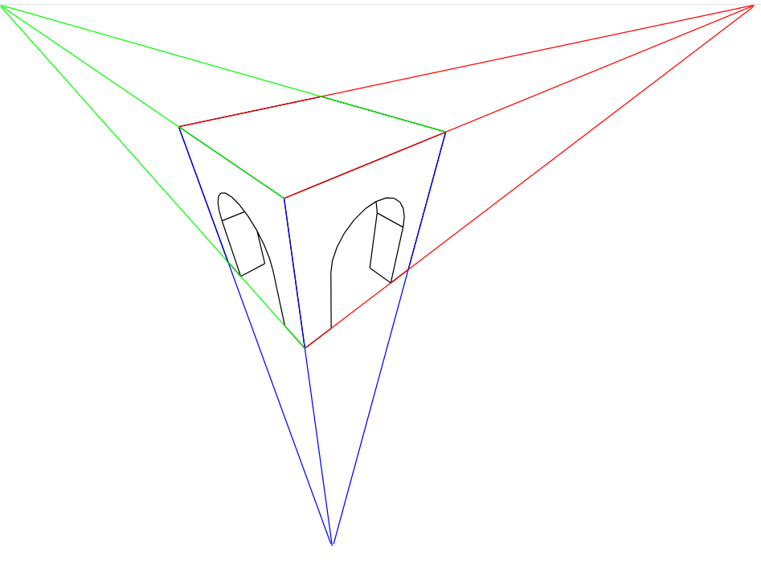
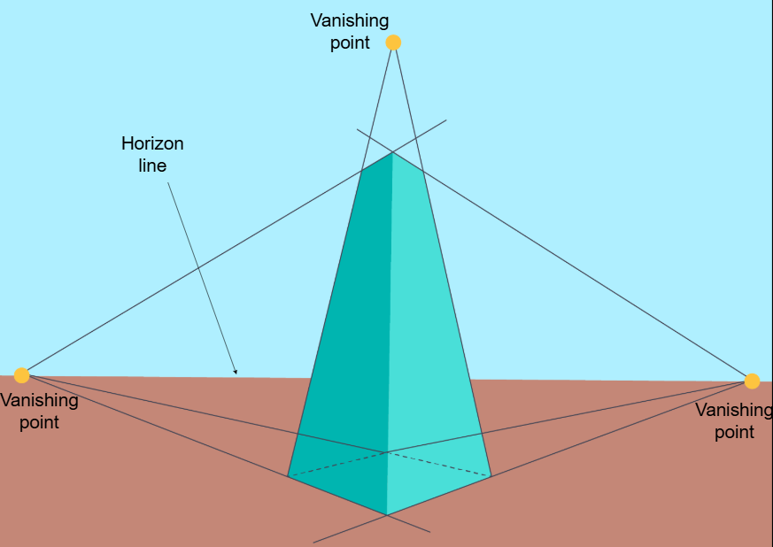
Three-point perspective

Slide 18
